Slide 1
OA Grace
For night alone that rests our thought
For quiet dawn that lights our trail
For evening fire that warms and cheers
For each repast that fuels our work
We give thanks, O Lord.

Slide 2
Dzie-Hauk Tonga Winter Banquet
<year>

Slide 3
Passing of the Bonnet Ceremony
<Previous Lodge Chief> and <New Lodge Chief>

Slide 4
State of the Lodge Address
<Lodge Chief>

Slide 5
Guest Speaker
<Speaker Name>

Slide 6
Unit of Excellence Award
<Presenter’s Name>

Slide 7
Uncas Award
<Presenter’s Name>

Slide 8
Uncas Award Recipients
Youth
Adults
<Youth Recipient Names go Here>
<Adult Recipient Names Go Here>

Slide 9
American Indian Affairs Award
<Presenter’s Name>

Slide 10
James E. West Award
<Presenter’s Name>

Slide 11
Founder’s Award
<Presenter’s Name>

Slide 12
<Place Founder’s Video Here>

Slide 13
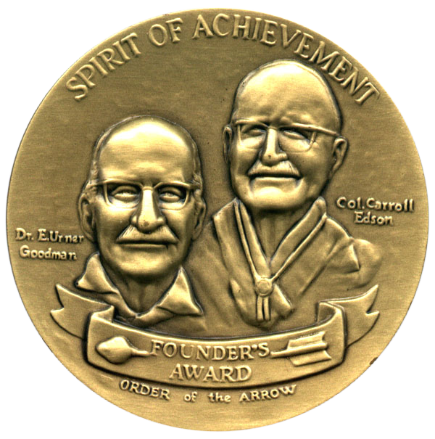
Founder’s Award

Slide 14
OA High Adventure
<Presenter’s Name>

Slide 15
Section G-6 Guest Speaker
<Presenter’s Name>

Slide 16
National Order of the Arrow Conference
<Presenter’s Name>

Slide 17
Vigil Recognition and Callout
Andrew Kirmer

Slide 18
Scout Executive Minute
Wayne Pancoast

Slide 19
Lodge Adviser’s Minute
Matt Riley

Slide 20
Dzie-Hauk Tonga Winter Banquet
<Year>

